Slide 1
ClimbCode
Notes:
Welcome to ClimbCode’s exposition. Here we’ll see the results of the development’s second sprint of this project.

Slide 2

Our Path Today
Idea
Technologies & Work
Things Done
Pilot Plan’s Results
Status
2
Notes:
This is the path we’re going to follow during the presentation. First we’ll introduce the idea behind ClimbCode, next we’ll see the technologies we’re using to develop ClimbCode, after that, we’ll talk about the things we’ve done, the results of our pilot plan and the current status of the project.

Slide 3
Idea
Notes:
We’ll start seeing which idea lies behind ClimbCode. But first, let’s travel a bit back in time:

Slide 4

4
Notes:
We’re sure everyone remembers those days at high school in which they had a lot of homework to do, copying the questions and doing them to show them in class. A bit boring and tiring, wasn’t it? And also for the teacher, because he/she also needed to search in the books the exercises he/she wanted us to do.

Slide 5

5
Notes:
Then… What if there was back in those days a way to do both things easier and faster? A way to do those tasks in our computers?

Slide 6

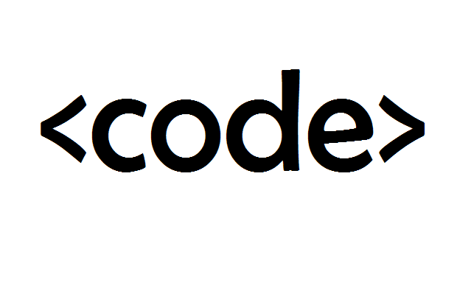
Idea
+
=
ClimbCode
6
Notes:
The answer to this is ClimbCode, our web platform, which acts as a supporting tool for teaching with the help of programming and software.

Slide 7


Idea
Interactive
7
Notes:
How do we grant this support? Simple, by interactive exercises, a better version of the original paper exercises made by independent programmers. Those exercises are bought by schools in order to increase their content catalog they have for supporting their subjects.

Slide 8


Learn Programming?
8
Notes:
But then, is it imperative to know programming to use our platform as a school? That is a question whose answer can be a little controversial, because even if we think it could be interesting to encourage programming in schools, our users don’t seem very interested on it, because the fact of having interactive exercises and all the things that it involves seems more interesting for them that the idea of programming.

Slide 9
Technologies & Work
Notes:
Now we’ll talk about the technologies we’re using to develop ClimbCode, and the work methodology we’re following.

Slide 10

Work Methodology
SCRUM
10
Notes:
In order to developt our project, we’ve chosen SCRUM as our work methodology with variations, like having weekly metings instead of daily ones, but always having in mind typical concepts such as the product backlog and the sprint backlog.

Slide 11




Technologies
Main:
11
Notes:
For the main development of our project, we’re using PostgreSQL, Django and Python for our back-end, and Bootstrap for our front-end.

Slide 12


Technologies
Deployment:
12
Notes:
For the deployment of the project, we’ve used mainly Digital Ocean, but at first we approached to Heroku before we discovered that it wasn’t as good as Digital Ocean in response times and availability. Despite that, we still have a version deployed in heroku in case that the Digital Ocean one doesn’t work.

Slide 13




Technologies
Interactive Exercises:
13
Notes:
For the interactive exercises’ system, we’re using JavaScript, with Ace for a little help with the syntax, Chart.js for creating the graphics and pictures for the exercises and AJAX.

Slide 14

Technologies
Knowledge:
14
Notes:
Finally, for our knowledge management we’re using a git repository hosted in GitHub.

Slide 15
Things Done
Notes:
Now we’ll see the things we’ve already done in our project.

Slide 16



Problems’ Status
PROBLEM | SOLUTION | METRIC | RESULT
 |  | TOTAL PROBLEMS (> 0) | Before: 0 After: 3
 | SP & PRIORITIES | ESTIMATION ERROR (< 10%) | Before: 36% After: 15%
19
Notes:
First, we’ve been analysing our problems and the solutions given to them, resulting in this table we see here. The table shows our principal problems: The first is the fact that we found difficult to document the problems we previously found. To solve it we decided to create a document in which we could put all the problems we could find during the development process. As we see, measuring the problems documented per week we can see that the problem has been completely solved, because the number of problems documented has increased, staying above the ratio of 0 we considered as the minimum acceptable level for this metric.
The second problem is that we found hard to estimate our tasks, so we decided to put Story Points on our requirements and relate them to our tasks, measuring the error between the estimations and the real time invested in those tasks. In addition, to increase the efficiency of the tasks’ distribution, we’ve also put a priority for each task in this sprint, allowing them to be distributed better and lowering our metric. The result of this is that the deviation has decreased, but still we need to keep improving this system in order to keep those figures the maximum amount of time that we can.

Slide 17


Problems’ Status
PROBLEM | SOLUTION | METRIC | RESULT
 |  | BIG TASKS (< 10%) | Before: 22% After: 17%
20
Notes:
Finally, the other problem we’ve tried to solve was that there were many big and indivisible tasks, so we decided to find ways to divide them and make them lighter and smaller. To measure the success of this solution we used the percentage of big tasks (more than 3 estimated hours) we have in our project, showing that the solution is working at the moment and the problem seems solved, but still needs to decrease to a 10%, which is the accepted limit for it.

Slide 18
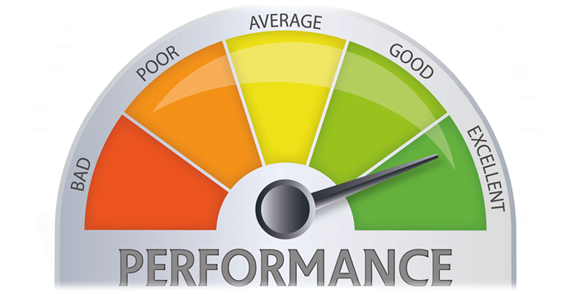
Performance
COMPLETED SP / REAL TOTAL HOURS
21
Notes:
We’ve also updated our metric to measure the performance of our team members in matters of tasks. The new version of the metric uses the current completed story points done by the member in the sprint, and the total amount of hours spent by that member for doing those story points, resulting in a percentage which shows the performance of the team member based on his tasks completed during the week and the hours spent on them.

Slide 19
Contingency Plan
Punishments
+
Team Building
+
Tasks’ Distribution
39
Notes:
During this sprint, we’ve also developed a contingency plan in case that problems inside our team appear. That plan is based in “punishments” done during our team building sessions, helping our rewards system, too. Also, in case of problem, the tasks of the sprint would be redistributed if a member can’t do his work, having also an emergency meeting in case that the problem gets too dangerous.

Slide 20


Features
Transactions
Interactive
Ordinary Use Cases
22
Notes:
In terms of features, we’ve finished all the ones we had as our MVP: Our interactive exercises’ system, allowing it to create and save them on our platform, our transactions’ system, allowing to buy and sell interactive exercises and letting programmers get their money from the purchases of the exercises, and many other minor use cases of our Django model.

Slide 21


Features
Security
Style
Feedback
23
Notes:
Those features include solving security problems, the preparation and correction of the style of our platform, and the implementation of all the feedback we’ve got during our pilot plan and that we could afford to include in our project.

Slide 22

Everyone’s Tasks
EVERYONE
5h 30min
27
Notes:
Talking now about the concrete tasks done by the team, everyone in the sprint has participated in meetings whose objective was to review the presentations of the sprint and see how the project was developing. That resulted in a total of 5 hours and 30 minutes per member.

Slide 23
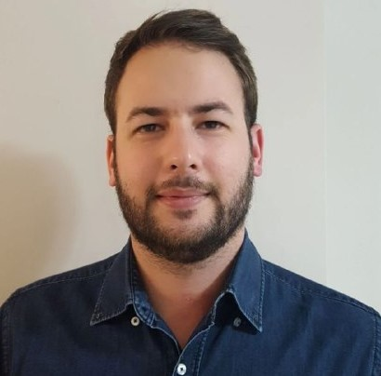

Personal Tasks
Alejandro Román, Project Manager
ESTIMATED
REAL
 | 2 h
 | 1h
29
Notes:
Now speaking member by member, Alejandro Román, our project manager, has been working this sprint helping with the second presentation of the sprint and with the analysis of our pilot plan’s results…

Slide 24

Personal Tasks
Alejandro Román, Project Manager
ESTIMATED
REAL
 | 22h | 17h
TASKS | 2h | 2h 15min
PROGRESS: 74% PERFORMANCE: 65%
28
Notes:
…Doing the tasks’ distribution and he’s also been working in the notebook’s read-only view, solving the problems left by last sprint and correcting its bugs. He has completed the X% of his tasks, with a performance of X% during this week.

Slide 25


Personal Tasks
Álvaro Domínguez, Business Manager
ESTIMATED
REAL
 | 10 h | 3h 40 min
 | 2h | 10 min
 | 8h | 5h 16 min
29
Notes:
Álvaro Domínguez, our business manager, has been working this sprint creating the two presentations done in it, their respective upgrade reports, the application of the pilot plan…

Slide 26
Personal Tasks
Álvaro Domínguez, Business Manager
ESTIMATED
REAL
WELCOME PAGE | 1 h | 47 min
CONTINGENCY PLAN | 1h | 23 min
PROGRESS: 57% PERFORMANCE: 130%
30
Notes:
The upgrade of our welcome page and the creation of the contingency plan. That resulted in a 57% of the progress of the task and a performance of 130% during this week.

Slide 27
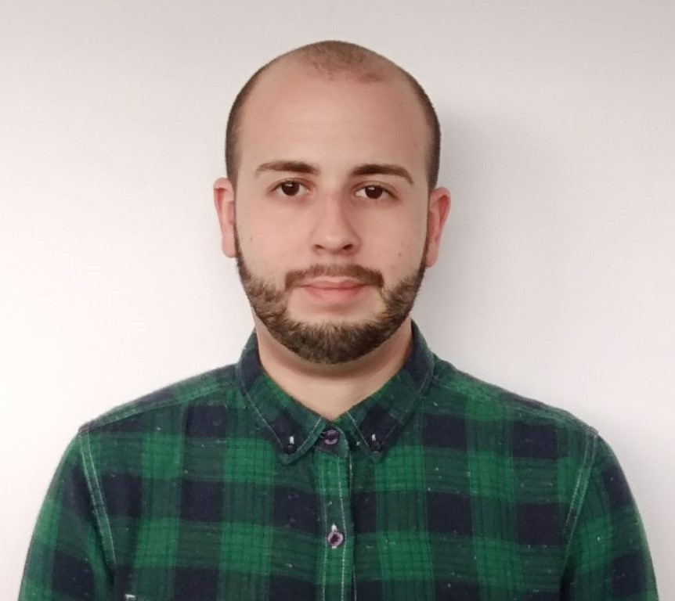

Personal Tasks
Miguel Ángel Baños, Front-End Developer
ESTIMATED
REAL
 | 18h | 20h
 | 8h | 10h
PROGRESS: 96% PERFORMANCE: 86%
31
Notes:
Now talking about our front-end developers, Miguel Ángel Baños has been working solving security issues related to our interactive exercises’ system, in its read-only view and solving other bugs and probelms in that system. He has completed his tasks in a X%, with a performance of X% this week.

Slide 28
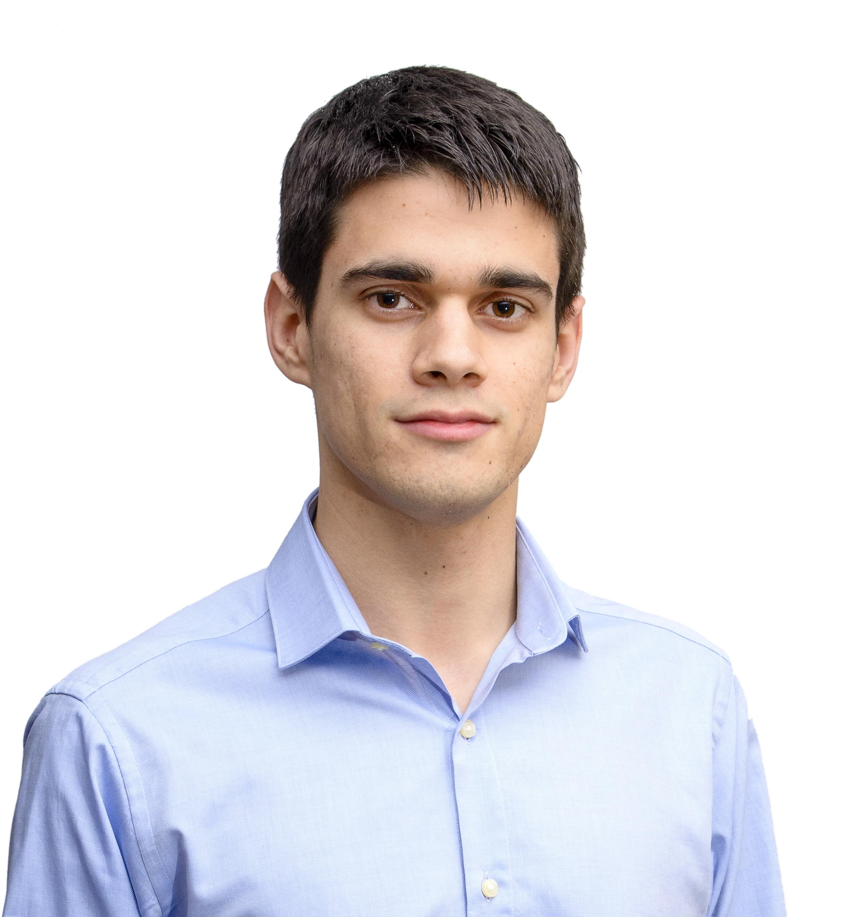
Personal Tasks
Alejandro Garrido, Front-End Developer
ESTIMATED
REAL
 | 21 h | 7h
METRICS | 1h | 30min
32
Notes:
Alejandro Garrido has been working in the upgrade of our platform’s style and navigability, in the management and update of our metrics…

Slide 29
Personal Tasks
Alejandro Garrido, Front-End Developer
ESTIMATED
REAL
BUDGET | 1 h
PROGRESS: 62% PERFORMANCE: 78%
34
Notes:
… And in the update of our budget, sorting it by each kind of spending. He has completed his tasks in a X%, with a performance of X% this week.

Slide 30
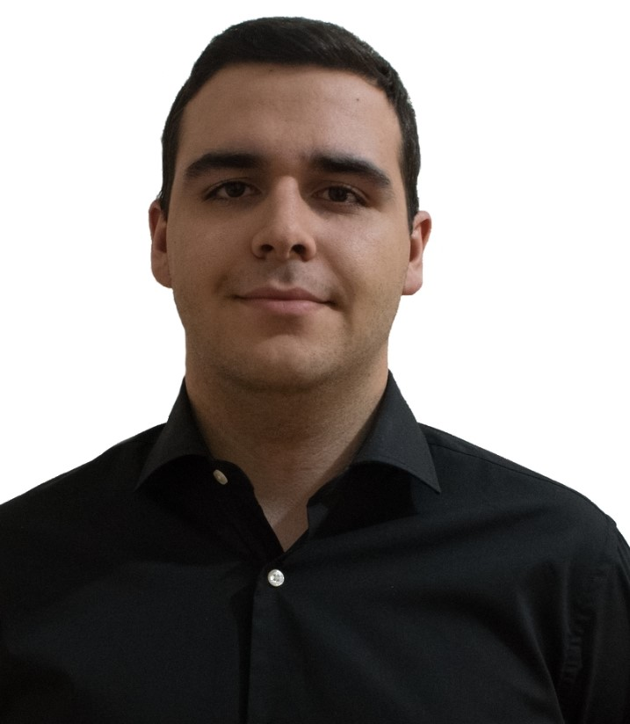
Personal Tasks
Andrés Ferández, Back-End Developer
ESTIMATED
REAL
 | 3 h | 2h 50min
 | 9h | 3h 16min
33
Notes:
Finally, about our back-end developers, Andrés Fernández has been working in solving bugs in our Django model, solving issues related to our platform’s security…

Slide 31

Personal Tasks
Andrés Ferández, Back-End Developer
ESTIMATED
REAL
 | 9 h | 10h 45min
PROGRESS: 62% PERFORMANCE: 78%
34
Notes:
… And in the possibility of registering teachers and students in our platform automatically using a .csv file. He has completed a X% of his tasks, with a performance of X% this week.

Slide 32
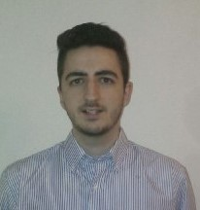

Personal Tasks
Jesús Sosa, Back-End Developer
ESTIMATED
REAL
 | 10h | 6h
 | 10h | 9h
 | 4h | 2h 30min
35
Notes:
Jesús Sosa has been working in the creation of our demos during this sprint, the solution of bugs in our Django model, the solution of security issues…

Slide 33
Personal Tasks
Jesús Sosa, Back-End Developer
ESTIMATED
REAL
INTERACTIVE EXERCISES | 3 h | 2h 32min
PROGRESS: 44% PERFORMANCE: 52%
36
Notes:
… And finishing our interactive exercises’ starting set. He’s had a performance of X% this week, finishing a X% of his tasks.

Slide 34
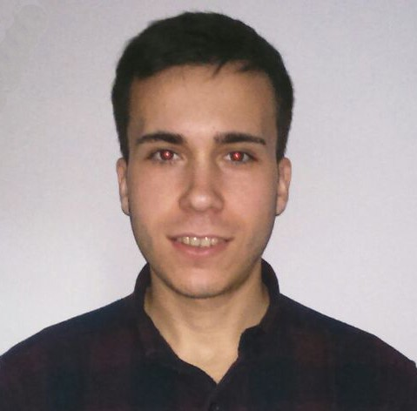
Personal Tasks
Álvaro Sánchez, Back-End Developer
ESTIMATED
REAL
 | 16h | 13h
 | 6h | 8h
37
Notes:
Finally, Álvaro Sánchez has been working in our transactions’ system, solving bugs in our Django model…

Slide 35
Personal Tasks
Álvaro Sánchez, Back-End Developer
ESTIMATED
REAL
 | 1h
PROGRESS: 62% PERFORMANCE: 78%
34
Notes:
… And helping with today’s presentation. He’s finished a X% of his tasks, having a performance of X% during this week.

Slide 36
Group’s Hour Deviation
38
Notes:
To see better the big picture behind the hours’ invested by each member, we have this graphic in which we can see the difference between the estimated hours and the real hours invested by each member during this sprint. As we see, the difference has significantly decreased since last time, but still there is work to do if we want to keep these figures.

Slide 37
Deployment & Demo
Deployment URL: www.climbcode.tk
Demo URL:
https://youtu.be/3YsYJetMqHo
26
Notes:
To show how the system works today, we’ve put a link in which everyone can see our project, and also we’ve created a demo, showing our star use case: The creation and buying of an interactive exercise.
Demo: https://youtu.be/3YsYJetMqHo
Paypal’s credentials for a school: schoolCC@hotmail.com / climbcodeISPP2018

Slide 38
Pilot Plan’s Results
Notes:
Now we’ll see the results of applying our pilot plan.

Slide 39


Pilot Plan
24
Notes:
We designed a pilot plan based in meetings with programmers and teachers, showing them our platform and asking them what did they think about our star use case (creation and purchase of interactive exercises), what suggestions did they have for our project, what did they think we could change, and how much would they pay for each thing of our platform (licenses and exercises).

Slide 40
Results: Feedback
DASHBOARD
25
Notes:
From the feedback we received, we decided to include the automatic registration of teachers and students with a .csv file, to keep safe the student’s personal information, not including programming in our platform for the schools, and including a dashboard showing the usage of teachers and students.

Slide 41


Results: Feedback
53
Notes:
Sadly, we couldn’t include other feedback due to our lack of time, such is the case of changing interactive exercises to pdf in order to print them, or correcting those exercises automatically.

Slide 42
Results: Figures
10 Users
53
Notes:
As a result of our pilot plan, we’ve got an amount of 10 users for our platform, from the 25 inverviewed, divided bewteen teachers and programmers as we see in the graphic. We’ve also received messages from other users asking to join the platform, so we expect to see an increasing in these numbers as time goes on.

Slide 43
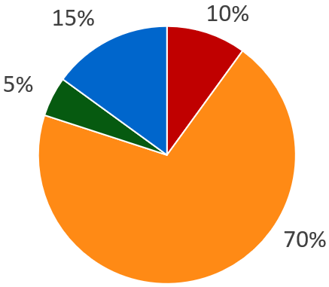
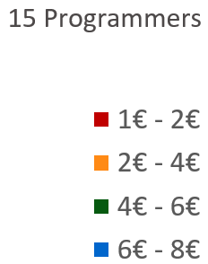
Results: Figures
Exercises’ price (Programmers)
53
Notes:
From all the programmers we’ve interviewed, we can see that many of them agree with the price of our interactive exercises in our platform, showing that the 70% of them says that the price given for the exercises whould be between 2 and 4 euros, which is the amount we’ve put for them.

Slide 44
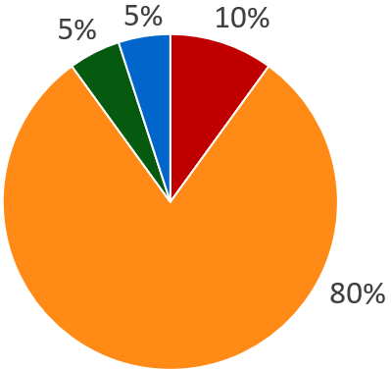
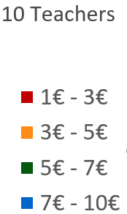
Results: Figures
Exercises’ price (Schools)
53
Notes:
Also, we’ve asked the schools for those prices too, showing again that they mostly agree with the one we’ve put, which is between 3 and 5 euros.

Slide 45
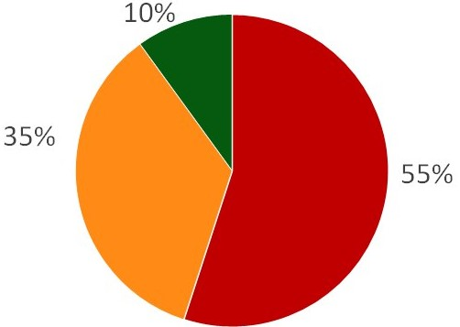
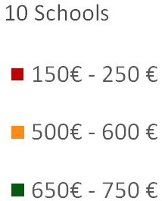
Results: Figures
Licenses’ price (Schools)
53
Notes:
Also, we asked the schools about the prices of the licenses, and they all agreed with us in our range of prices, showing that they would pay between 150 and 250 euros, which is the price of our smallest license, or between 500 and 600 euros, which is the one of our medium license.

Slide 46
Status
Notes:
Finally, we’ll see the current situation of the project.

Slide 47
Current Costs & Time
0%
50%
100%
€16K
900 h
€29K
1120 h
Current: €55%, 80% h
Budgeted: €50%, 50% h
41
Notes:
Currently we’ve spent a total amount of 900 hours and 16k euros, which is a 80 and a 55 percent from the total, and different from the 50 expected this week.

Slide 48
Costs’ Explanation
41
Notes:
That money investment is divided in direct and indirect costs, X and Y, having the amount shown in the slide for each one.

Slide 49
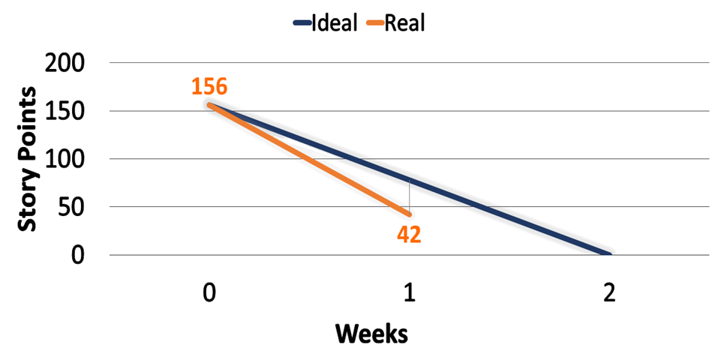
Current Sprint’s SP
42
Notes:
These hours and money investments are visible in these burndown graphics. The first one shows us the amount of Story Points done at this moment of the sprint, comparing it to the ideal development of the sprint itself. As we see, PATATA.

Slide 50
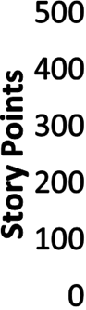
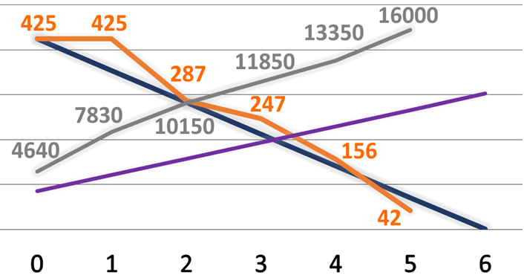
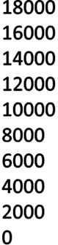

Current Project’s Situation
43
Notes:
The second graphic shows us the Story Points done during the full development of the project, comparing it with the remaining for the whole project and the ideal development of it. As we see, PATATA.

Slide 51

Current Project’s Usage
Current usage: 56%
Evolution: +4 users/week
43
Notes:
Seeing those figures makes us think about the viability of our project. In order to measure it, we decided to study the current usage of our platform. We saw that the current number of users is the 56% of the ones inverviewed, with an increase of 4 users per week.

Slide 52
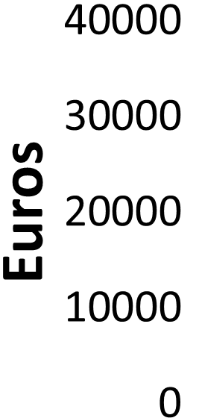
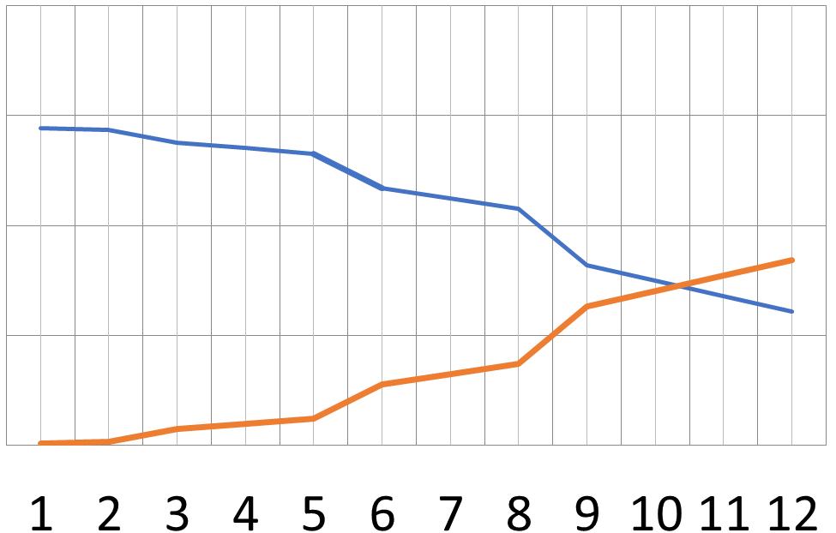



Breaking Point
43
Notes:
Having that in mind, we can see that our breaking point is located on the 10th month after the release of the product, increasing the number of users in the amount we’ve seen before, and having an average purchase of exercises of 10 per month.

Slide 53

Conclusions
DEVELOPMENT FINISHED
55
Notes:
So, as a conclusion, we can say that we have finished the development of our project, and now a new phase begins, more focused in marketing and getting more users for our project.
This situation is all thanks to our team’s effort in the development phase, and that makes us very positive in our project, becasue if we did this good during development, we can expect a good performance during the next phases of the project, too.

Slide 54

THANKS!
You can find me at
alvdomnun@alum.us.es
56
Notes:
And that’s the end of our presentation! Thank you for watching, and if you have any doubt you can contact me at alvdomnun@alum.us.es.

